Slide 1
Predictive Modeling II (Predict 411)
Northwestern University, School of Continuing Education
Masters Program in Predictive Analytics
Sync Session 1
January 7th, 2013; January 8th,2013; January 12th, 2013
Vivek B. Ajmani, Ph.D.
Business Intelligence & Analytics Manager
Strategy & Patient Data Management
Cardiac Rhythm Disease Management
Medtronic, Inc.

Slide 2
Table of Contents
Introductions
Predict 410 (Recap)
Predict 411 (In a nutshell)
The Syllabus
The Blackboard
Week 1 DQ
Week 1 Assignment
Grading Week 1
Late Assignments (Week 1)
Ramblings, Strategy and Other Thoughts
Conclusions

Slide 3
Is the grass greener on the other side? Or,
Do I keep moving up the hill to get a better view?
(An Introduction)
Trained as a chef, but wanted to manage restaurants (1982-1986);
Wanted to be a computer scientist, but ended up being a computer scientist, a mathematician and a statistician (1987-1990);
Self Discovery or Waste of Time? (1990-1991);
Operations Research and Applied Mathematics is my passion (1991-1992);
Hold It! Statistics is my real passion (1992-1997);
Eastman Kodak→3M→Intel→General Mills (1996-2006);
I’m missing out on Predictive Analytics!!
  Ameriprise Financial→US Bank→United Health Care (2006-2012)
Was the grass all that greener on the other side?
  Medtronic (2012- …)

Slide 4
Academics, Industry or Both?
University of Florida, Gainesville, FL (1992-1994)
  Teaching Assistant; Student Lecturer (Department of Statistics)
St. Edward’s University, Austin, TX (1999-2000)
  Adjunct Faculty (Graduate School of Business, Undergraduate Liberal Arts and Sciences)
University of Phoenix Online (2002-2009)
  Adjunct Faculty (Graduate School of Business, Undergraduate Liberal Arts and Sciences)
Devry University Online/On Campus (2005-…)
  Adjunct Faculty (Undergraduate and Graduate School)
University of Minnesota, Minneapolis, MN (2008)
  Adjunct Faculty (Carlson School of Management)
Northwestern University (2011- …)
  Faculty Lead in the MS Predictive Analytics Program
  Taught Predict 410 (Predictive Analytics I)
  Designed (and teaching) Predict 411 (Predictive Analytics II) (Summer ‘12 – Summer ’13)

Slide 5
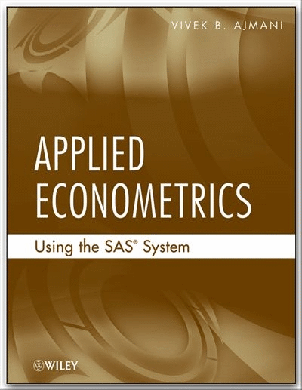
Shameless Advertisement

Slide 6
Contact & Personal Information
vivek.ajmani@northwestern.edu
952-201-8237 (C)
952-474-1346 (H)
Born: Calcutta, India (Lived here for 6 years)
Raised: Bombay, India (Lived here for 17 years)
Hometown: Chanhassen, MN, USA
Married with kids
Working style: Laidback (but Relentless)
Personality: Blunt and Direct
Hobbies: Photography (StatChef on Flickr), Blues & Jazz, Toy Trains

Slide 7
Predict 410 (Recap)
Introduction to Predictive Analytics
OLS Regression
  Simple Linear Regression
  Multiple Linear Regression
Logistic Regression
  Simple Logistic Regression
  Multiple Logistic Regression
Survival Analysis
  Proc LifeTest
  Proc LifeReg
  Proc PhReg
Multivariate Statistics
  Principal Components Analysis
  Factor Analysis
  Cluster Analysis

Slide 8
Predict 411 (In a Nutshell)
OLS Regression-Simple, Multiple, Underlying Assumptions, General Linear Hypothesis
Heteroscedasticity, Measurement Errors, Omitted Variables, Proxy Variables
Logistic Regression, Poisson Regression, Negative Binomial Regression
Panel Data Analysis (Fixed Effects, Random Effects)
Seemingly Unrelated Regressions (SUR), Simultaneous Equation Models (SEM)
Time Series Analysis (Serial Correlation, Model Identification, Model Fitting, Model Validation, Forecasting) {Box Jenkins Analysis}
Duration Analysis Models

Slide 9
Syllabus, Blackboard
Let’s take a quick walk-through both

Slide 10
Week 1 DQ, Assignment
Let’s take a quick walk-through both

Slide 11
Grading Week 1
Rambling here---But, useful information

Slide 12
Late Assignments (Week 1)
First response to first DQ question must be posted by 11:59 PM CST on Wednesday (01/9/2013)
Second response to first DQ question must be posted by 11:59 PM CST on Thursday (01/10/2013)
First response to second DQ question must be posted by 11:59 PM CST on Friday (01/11/2013)
Second response to second DQ question must be posted by 11:59 PM CST on Saturday (01/12/2013)
Main response worth 7 points each. Secondary response worth 3 points each (20 points total)-50% of each for any delays. One grace period with 24 hours notice.

Slide 13
Late Assignments (Week 1)
Week 1 assignment due by 11:59 PM CST on Sunday 01/13/2013.
  The paper must be turned in via SafeAssign.
  You can turn in the SAS files through the regular assignment link or via email.
  One grace period with 24 hours notification.
  25% off per 12 hour period otherwise (50% for a delay of one day)

Slide 14
Ramblings, Strategy, and Other Thoughts
Take one week at a time; Within the week, take one day at a time; Within each day, take one post at a time…
DQ + Assignments = 65% of your grade. At the minimum, max this out.
  Within the DQ + Assignments world, you will learn a lot.
  Burden on you to go above and beyond to read the “extras.”
  Burden on me to add value to the class beyond the DQ + Assignments world. How do I do this?
Participate, Partner, Collaborate, Network

Slide 15
Ramblings, Strategy, and Other Thoughts
Have fun; I need to know when the fun ends and the pain begins.
  Talk to me (first);
  Escalate to the University (next);
Keep me in the loop on any difficulty with the course material (SAS code, theory, concepts, applications).
  Pick up the phone and call me.
Be respectful under any and all circumstances.

Slide 16
No Surprises
You should not be surprised by your assignment feedback/final grade.
I should not be surprised by the final course evaluations ☺

Slide 17
Conclusions
Q&A
If yes;
  Fire away;
If no;
  Good Night & Good Luck;

